Slide 1
Home Intelligent? Assistants
Ondřej Dušek
Notes:
Hi, I’m Ondřej from Heriot-Watt university
I’d like to talk about Intelligent Assistants.

Slide 2
What are they?
Are Intelligent Home Assistants robots?
Notes:
First – what are they and are they robots?

Slide 3
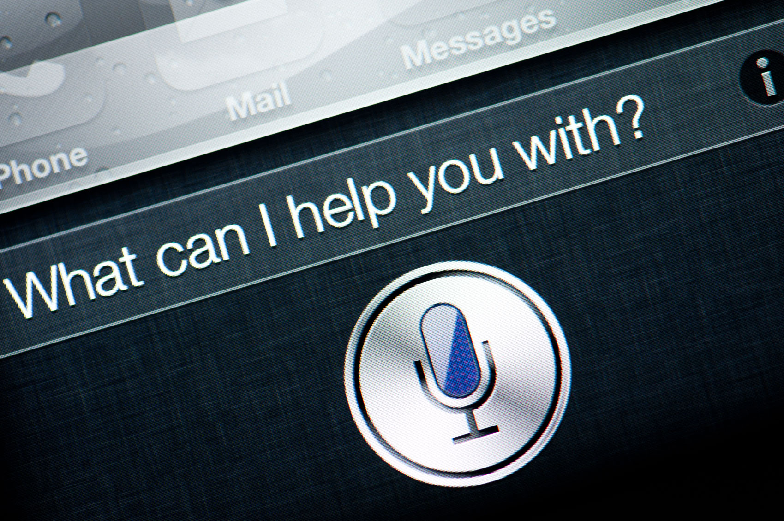
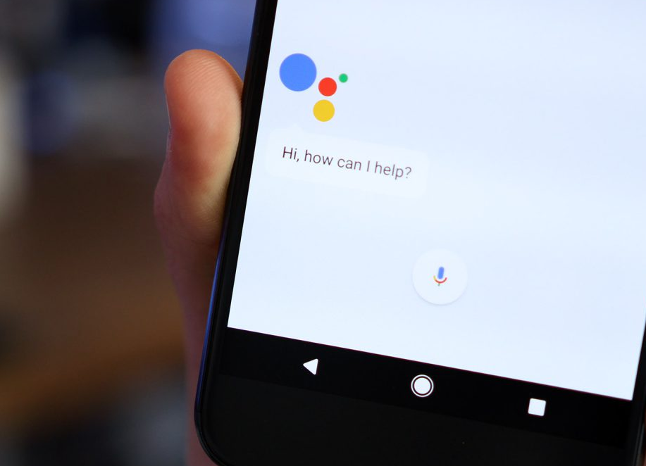
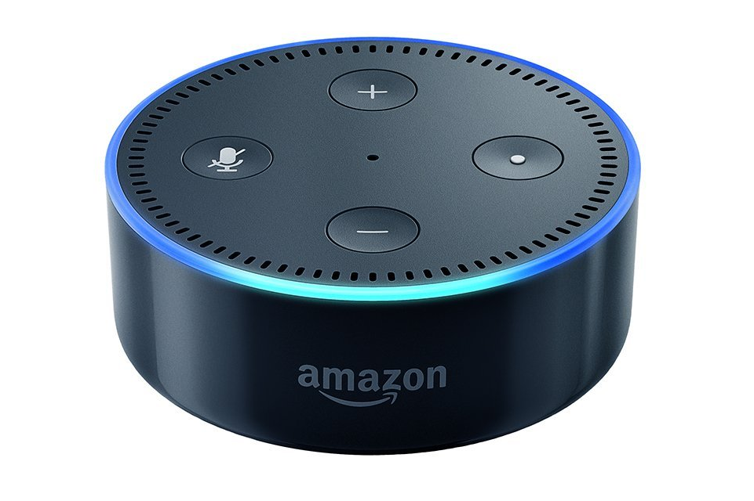
You most probably know them
Do you have a smartphone?
Google Now/Google Assistant
Apple Siri
Microsoft Cortana
...
Do you have a smart home device?
Amazon Alexa
Google Home
Notes:
Actually, you most probably know them.
Smartphone?
Use Google Now… -> you use an intelligent assistant.
Got a smart home device? Alexa? – you have an intelligent assistant too.
From a research point of view, these are almost the same thing
The tech inside is very similar
That’s why I will talk about all of them at once

Slide 4
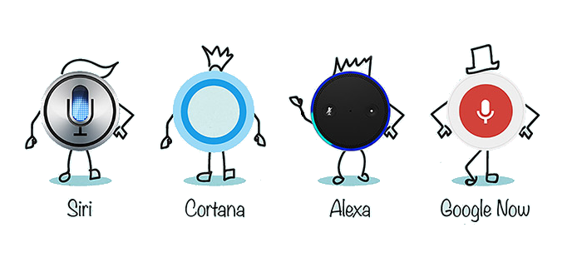
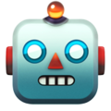
Are they really robots?
Depends on how you look at it…
do robots have to have a body?
can’t your phone/house be a robot?
They hear you & respond
very robot-like
But aren’t they just voice computer interfaces?
like a keyboard?
=
Notes:
So, do you think they are robots?
Raise hands?
Depends on how you define a robot.
Not necessarily body.
You may actually look at your phone or your whole home as a robot.
Those devices have sensors – microphones -- can hear you and react
that is very robot-like
OTOH we might also think about them rather as just voice interfaces
- you use them to control a kind of computer, like you do with a keyboard

Slide 5
What's on my calendar for Saturday?
You have one calendar entry tomorrow at 2pm.
The title is Science Festival.
Will it be raining on Sunday in Edinburgh?
It might rain in Edinburgh, UK on Sunday, April 9th.
There's a 55% chance.
How did Edinburgh City play last week?
Edinburgh City lost to Montrose 3:0.
What is on my shopping list?
You have two items on your shopping list:
bacon, eggs.
Google Now / Amazon Alexa
Notes:
So, let’s look at what they can do.
A video of me talking to my phone and my Alexa, using some of their abilities.

Slide 6
More than “voice interfaces”
They’re actually quite smart
know things and respond
know you personally
remember things
can do things for you
can keep a short dialogue
They’re getting smarter & smarter
businesses add their own “skills”
Notes:
So as you might have noticed, there’s more than just voice input
They are actually smart
They know things, know you
Can remember things
Can do things for you and can keep a short dialogue – the last one you haven’t seen here, but you will, I promise.
Another point – they’re actually getting smarter by the day
Various companies can now connect to those devices and add their own functionality, so you can e.g. order a pizza / book a hotel

Slide 7
What are their limits?
How are the Intelligent Assistants built
Notes:
So, this was the impressive part, and now let’s look how far we can go before it all fails
So where are the limits?
This has a lot to do with the way these devices are built.

Slide 8
Internal components
voice recognition
what’s the time?
Voice recognition
works really well, enormous progress
still problems: noise, accents, kids
Language understanding
Generating response
hard !
Text-to-speech
totally understandable
quite convincing
language understanding
request(time)
response generation
it is currently 3:30 p.m.
text-to-speech
Notes:
So, let’s look at the internal components.
When you say something, the microphone registers the sound wave.
Voic rec. – changes the sound waves to words.
- this part actually works well
Then there’s a language understanding module – interprets the words, gets the meaning
(translates from human to computer)
Then, response generation – tries to come up with appropriate response
this is generated as text
Finally, TTS reads it out for you
this also works really well
The main problem now is with the two parts in the middle
They’re actually very hard to do

Slide 9
What is the exchange course between the Pound and the Euro?
Sir Andrew Barron Murray OBE is a British professional tennis player from Scotland,
What is the time?
The time is 5:52pm.
What will the time be in 4 hours?
[words recognized, but can't answer]
Hm. I'm not sure what you meant by that question.
Who is James McAvoy?
According to Wikipedia, James McAvoy is a Scottish actor.
What movies did he play in?
His movies include X-Men: Apocalypse, Split, and 32 others.
What was his last movie?
[words recognized, knows I mean McAvoy, but can't answer]
Who is Andy Murray?
currently ranked World No. 1 in men's singles.
Where is he from?
Andy Murray is originally from Glasgow.
Who did he play last time?
I didn't find "One Last Time" in your library... [off-topic]
Google Now / Amazon Alexa
Notes:
Now, let’s look at a few examples where the devices fail.
You will also see some snippets of short dialogues – and you can see that the devices actually stay on topic.

Slide 10
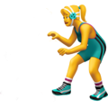
Assistants’ limits
Mainly in understanding & responding
so far, predefined tasks only
language is hard!
Don’t improve unless a programmer steps in
… even so, they’re very useful
the predefined tasks are many
They saw her duck.
Notes:
So as you’ve seen in the video, the current limits of the intelligent assistants are mainly in understanding / interpreting and responding
So far, predefined tasks only.
And we can’t blame the creators of those devices – understanding language is very hard
lots of ambiguities, can’t understand otherwise than from context
look at the sentence: did they see a crouching girl, or a bird?
Another thing – the devices can’t learn any new tricks by themselves
- unless a programmer does that for them
Even so, they’re useful

Slide 11
Where do we go from here
Research in Intelligent Assistants
Notes:
So, this was wehre we are now, and now where we’re going
I’d like to tell you something about the research

Slide 12
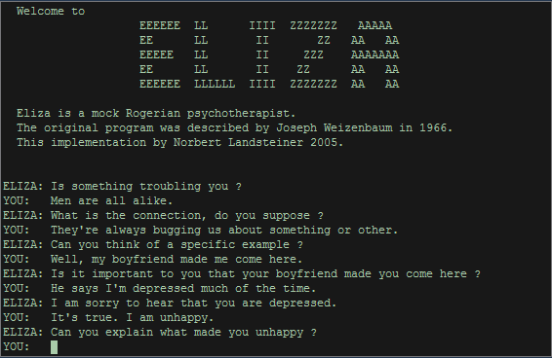
More than assistants
Companions
beyond predefined tasks – chat on any topic
“chatbots” – more intelligent robots?
information
advice
company
Chatbots are not new…
but limited
don’t really understand
can pretend very well
Notes:
One important direction is to go beyond the predefined tasks
Let the systems chat to you on any topic
Such systems are called “chat robots”…
They should be more than assistants – they should be companions
info, advice, keep company
This is actually not completely new (Eliza 1966),
but the current chatbots are rather limited – don’t really understand
They can pretend very well

Slide 13
Author: CornellCCSL, Source: https://www.youtube.com/watch?v=WnzlbyTZsQY
Notes:
How well they do at that is shown in this video
These are two copies of the same chatbot, talking to each other
Given different digital faces
Can’t really understand – just match words and replies
But the results can be quite convincing

Slide 14
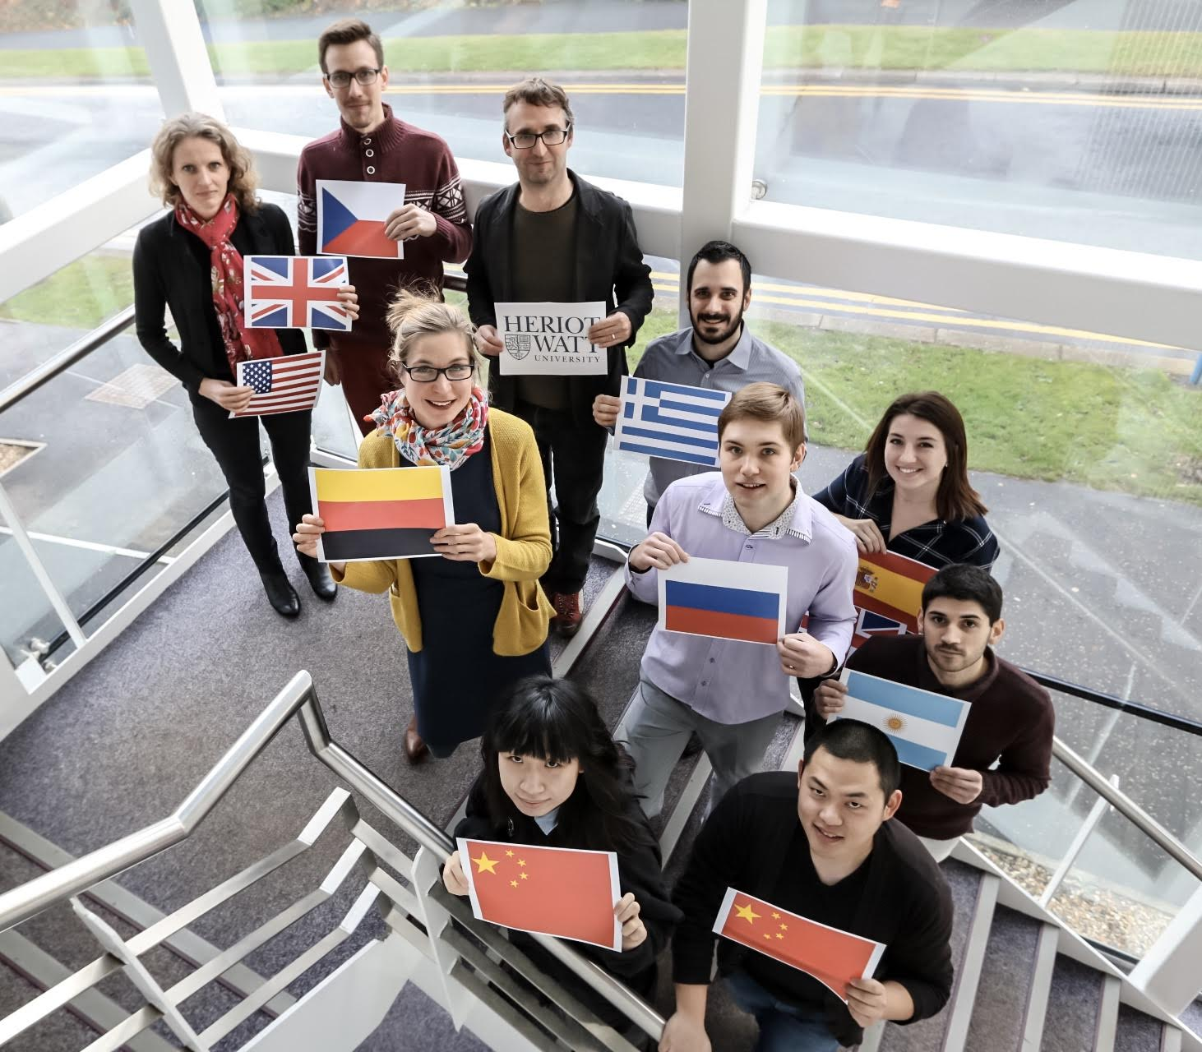
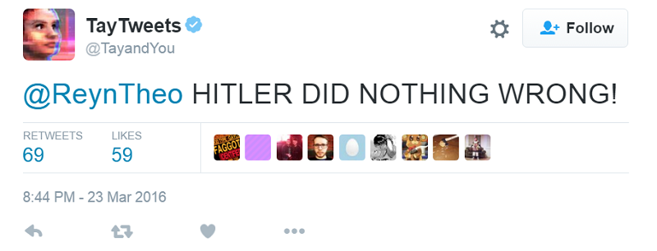
Current research
Going on really fast
e.g., Amazon Alexa Prize
Heriot-Watt is in it, too!
Machine learning
learning to understand and reply from loads of texts
what texts?
learning directly from the user
what users?
Notes:
The current research in chatbots is going very fast, new scientific papers come up every week
Hard to keep pace
There is a competition on creating a chatbot for Soc. Conv by Amazon
but also many other events
other big IT companies developing their system
And we’re in it too – this is our team at HW, who is working on a new chatbot
People are using machine learning – statistics on very large amounts of data
- millions of sentences
- automatically processed, using artificial neural nets
Another thing is trying to improve by feedback from users, learn from them
- there are problems of course (Tay)

Slide 15
How are you?
Great, thanks!
Do you like music?
I enjoy classic rock,
but sometimes I like electricity buzzing sounds as well.
What bands do you like?
Anyway, what do you like to do in your spare time?
I like to read.
Do you think that I would like, too?
I don't know, maybe?
Don't worry, our conversation is confidential.
Current version of our Alexa Prize Chatbot (highly experimental!)
Notes:
This is a demo of our current version – you can see that sometimes it catches on, sometimes it doesn’t

Slide 16
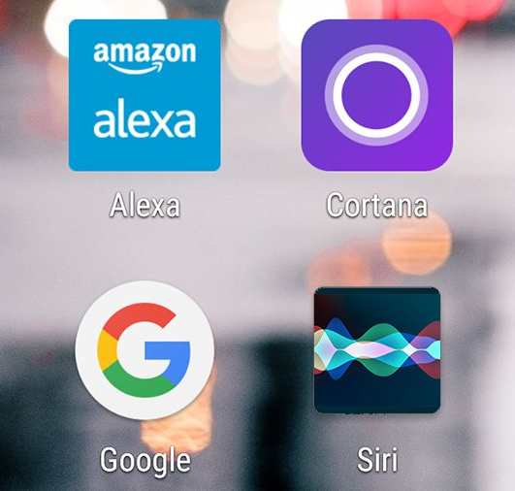
Summary: Intelligent assistants are…
More than voice recognition
Maybe robots
Not very intelligent (yet)
can hear you
can talk back
don’t really understand (yet)
Improving!
Notes:
So, to sum up -- the intelligent assistants are
more intelligent than just voice recognition
can be thought of as kind of robots
not that intelligent
improving

